Slide 1
CSE 405
IO Interfacing
Osama Hosameldeen
Spring 2021

Slide 2
Instructor
Instructor
  Osama Hosameldeen
  Associate Professor, Computer and Information Security
  E-mail: ohosameldeen@aldar.ac.ae
© 2015 ELSIVER, All rights reserved. compiled by Dr. Osama Hosameldeen

Slide 3
Course Overview
Course: IO Interfacing
Time: 8:30-11:30 am on Sundays
Classroom: Zoom (Online)
Prerequisite: Computer Architecture, Electronic Circuits, Signal Processing
© 2015 ELSIVER, All rights reserved. compiled by Dr. Osama Hosameldeen

Slide 4
Office hours
I’ll be available Monday from 5PM to 11PM
If you need to contact me, send an email to ohosameldeen@aldar.ac.ae I’ll then send you zoom link so we can talk.
© 2015 ELSIVER, All rights reserved. compiled by Dr. Osama Hosameldeen

Slide 5
Target Students
For those who
  Major in Computer Engineering, Embedded Systems
  Are familiar with basic computer architecture, logic design, signal processing.
  Are preparing to investigate more details in selected topics and recent developments in auto control, embedded systems, industrial control.
© 2015 ELSIVER, All rights reserved. compiled by Dr. Osama Hosameldeen

Slide 6
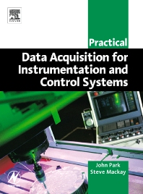
Resources
Textbook: John Park and Steve Mackay, Practical Data Acqusition for Instrumentation and Control Systems, ELSEVIER, 2006
References:
Jayantha Katupitiya and Kim Bentley, “Interfacing with C++: Programming Real-World Applications,” Springer, 2006.
Kelvin James, “PC Interfacing and Data Acquisition: Techniques for Measurement, Instrumentation and Control,” Newness (Butterworth-Heinemann), 2000.
Stephen Derenzo, “Practical Interfacing in the Laboratory: Using a PC for Instrumentation, Data Analysis and Control,” Cambridge University Press, 2003.
R. A. Penfold, “Easy PC Interfacing,” Bernard Babani Publishing, 2002.
Jeffrey Travis, “LabVIEW for Everyone,” 2nd Ed., Prentice Hall, 2002.
Kenneth Ashley, “Analog Electronics with LabVIEW,” Prentice Hall, 2003.
© 2015 ELSIVER, All rights reserved. compiled by Dr. Osama Hosameldeen

Slide 7
Teaching
Lectures
About 3-4 homework assignments
  Written and programming exercises
  Homework should be turned in within two weeks
two quizzes, and one mid-term exam
© 2015 ELSIVER, All rights reserved. compiled by Dr. Osama Hosameldeen

Slide 8
Course Description
This Course is designed to introduce students to different types of I/O Interfacing including
ISA, EISA, PCI, PXI busses,
Parallel Port interfacing.
Serial Port Interfacing.
USB Port interfacing,
IEEE 488 (GPIB) and
RS-232 standards,
Hardware and software interrupts, programmable interrupt controllers,
DMA control and DMA controllers.
Applications for I/O Interfacing using different kinds of sensors/transducers.
© 2015 ELSIVER, All rights reserved. compiled by Dr. Osama Hosameldeen

Slide 9
Aim
To introduce the basic concepts and techniques used in I/O Interfacing and
to develop practical skills of students in computer interfacing and virtual instrumentation Using LabView.
© 2015 ELSIVER, All rights reserved. compiled by Dr. Osama Hosameldeen

Slide 10
CLOs
CLO1 | Explain the basic concepts and techniques for I/O Interfacing
CLO2 | Describe and implement Parallel Port and Serial Port interfacing techniques
CLO3 | Explain and implement USB Port interfacing techniques
CLO4 | Utilize different types of interrupts for practical applications
CLO5 | Utilize plug-in multifunction cards in different applications involving A/D and I/O Techniques
CLO6 | Develop virtual instruments using LabVIEW
© 2015 ELSIVER, All rights reserved. compiled by Dr. Osama Hosameldeen

Slide 11
Lecture 1
Introducing I/O interfaces
© 2015 ELSIVER, All rights reserved. compiled by Dr. Osama Hosameldeen
Notes:
This book focuses on two broad areas: cryptographic algorithms and protocols, which
have a broad range of applications; and network and Internet security, which rely
heavily on cryptographic techniques.

Slide 12
Definition
Data acquisition is the process by which physical phenomena from the real world are transformed into electrical signals that are measured and converted into a digital format for processing, analysis, and storage by a computer.
Data Acquisition (DAQ) system is designed not only to acquire data, but to act on it as well.
© 2015 ELSIVER, All rights reserved. compiled by Dr. Osama Hosameldeen

Slide 13
DAQ and Control
Control is the process by which digital control signals from the system hardware are convened to a signal format for use by control devices such as actuators and relays.
These devices then control a system or process.
Where a system is referred to as a data acquisition system or DAQ system, it is possible that it includes control functions as well.
© 2015 ELSIVER, All rights reserved. compiled by Dr. Osama Hosameldeen

Slide 14
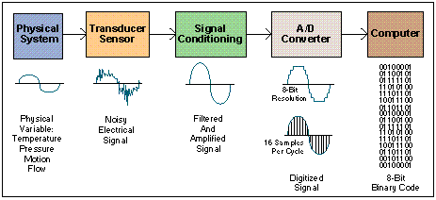
Data Acquisition System
Block Diagram
© 2015 ELSIVER, All rights reserved. compiled by Dr. Osama Hosameldeen

Slide 15
Elements of a data acquisition system
Sensors and transducers
Field wiring
Signal conditioning
Data acquisition hardware
PC (operating system)
Data acquisition software
© 2015 ELSIVER, All rights reserved. compiled by Dr. Osama Hosameldeen

Slide 16
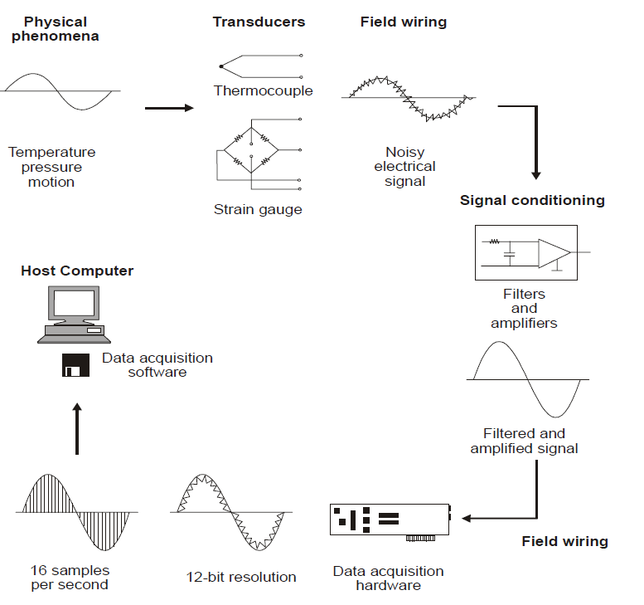
Functional diagram of a PC-based data acquisition system
© 2015 ELSIVER, All rights reserved. compiled by Dr. Osama Hosameldeen

Slide 17
Sensors and Transducers
Transducers and sensors provide the actual interface between the real world and the data acquisition system by converting physical phenomena into electrical signals that the signal conditioning and/or data acquisition hardware can accept.
© 2015 ELSIVER, All rights reserved. compiled by Dr. Osama Hosameldeen

Slide 18
wiring and communications cabling
Field wiring represents the physical connection from the transducers and sensors to the
signal conditioning hardware and/or data acquisition hardware.
When the signal conditioning and/or data acquisition hardware is remotely located from the PC, then the field wiring provides the physical link between these hardware elements and the host computer.
© 2015 ELSIVER, All rights reserved. compiled by Dr. Osama Hosameldeen

Slide 19
Signal conditioning
• Filtering
• Amplification
• Linearization
• Isolation
• Excitation
© 2015 ELSIVER, All rights reserved. compiled by Dr. Osama Hosameldeen

Slide 20
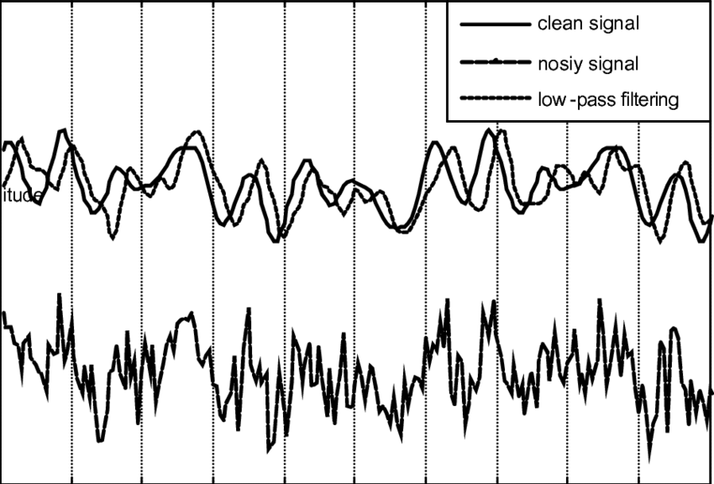
Filtering
In noisy environments, it is very difficult for very small signals received from sensors such as thermocouples and strain gauges (in the order of mV), to survive without the sensor data being compromised.
© 2015 ELSIVER, All rights reserved. compiled by Dr. Osama Hosameldeen

Slide 21
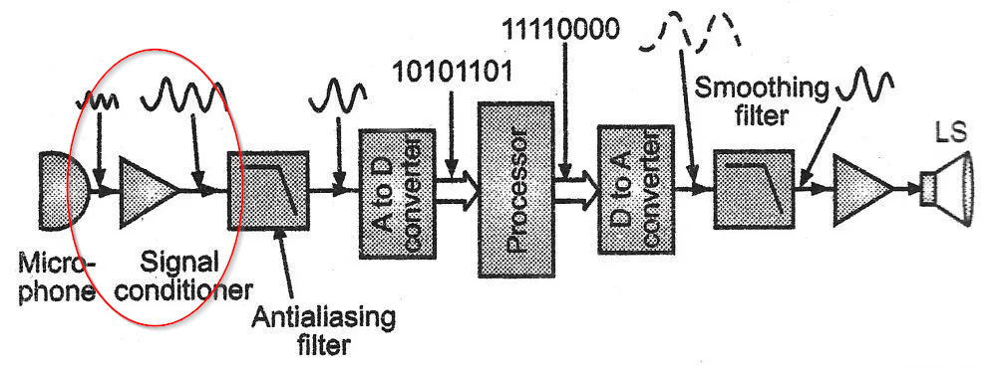
Amplification
Having filtered the required input signal, it must be amplified to increase the resolution.
The maximum resolution is obtained by amplifying the input signal so that the maximum voltage swing of the input signal equals the input range of the analog-to-digital converter (ADC), contained within the data acquisition hardware.
© 2015 ELSIVER, All rights reserved. compiled by Dr. Osama Hosameldeen

Slide 22
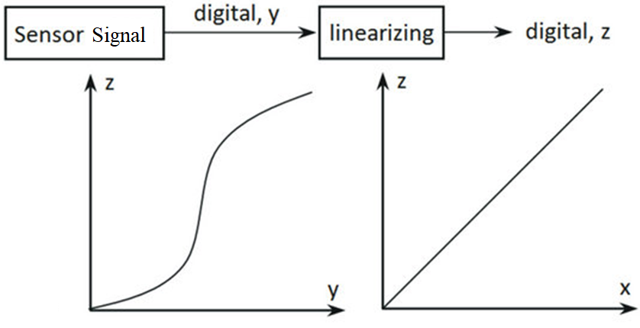
Linearization
Many transducers, such as thermocouples, display a non-linear relationship to the physical quantity they are required to measure.
The method of linearizing these input signals varies between signal conditioning products.
© 2015 ELSIVER, All rights reserved. compiled by Dr. Osama Hosameldeen

Slide 23
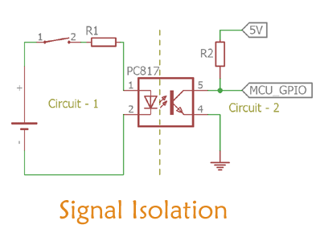
Isolation
Signal conditioning equipment can also be used to provide isolation of transducer signals from the computer where there is a possibility that high voltage transients may occur within the system being monitored, either due to electrostatic discharge or electrical failure.
Isolation protects expensive computer equipment
© 2015 ELSIVER, All rights reserved. compiled by Dr. Osama Hosameldeen

Slide 24
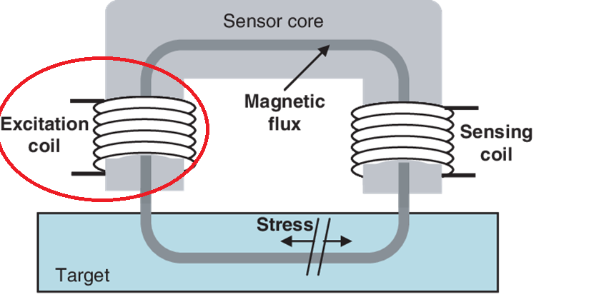
Excitation
Signal conditioning products also provide excitation for some transducers.
For example:
  Strain gauges, thermistors and RTDs, require external voltage or current excitation signals.
© 2015 ELSIVER, All rights reserved. compiled by Dr. Osama Hosameldeen

Slide 25
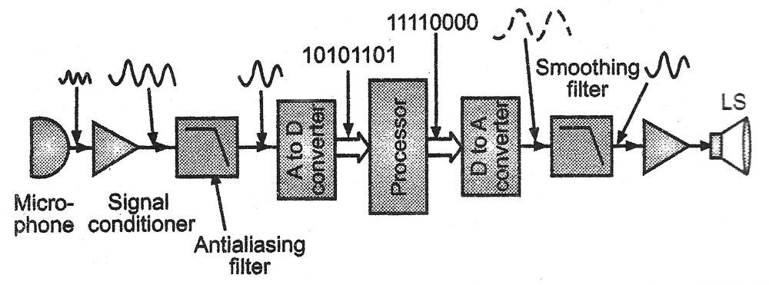
Functions of Acquisition hardware
The input, processing and conversion to digital format, using ADCs, of analog signal data measured from a system or process – the data is then transferred to a computer for display, storage and analysis the input of digital signals, which contain information from a system or process
© 2015 ELSIVER, All rights reserved. compiled by Dr. Osama Hosameldeen

Slide 26
Functions of Acquisition hardware
The processing, conversion to analog format, using DACs, of digital signals from the computer – the analog control signals are used for controlling a system or process the output of digital control signals
© 2015 ELSIVER, All rights reserved. compiled by Dr. Osama Hosameldeen

Slide 27
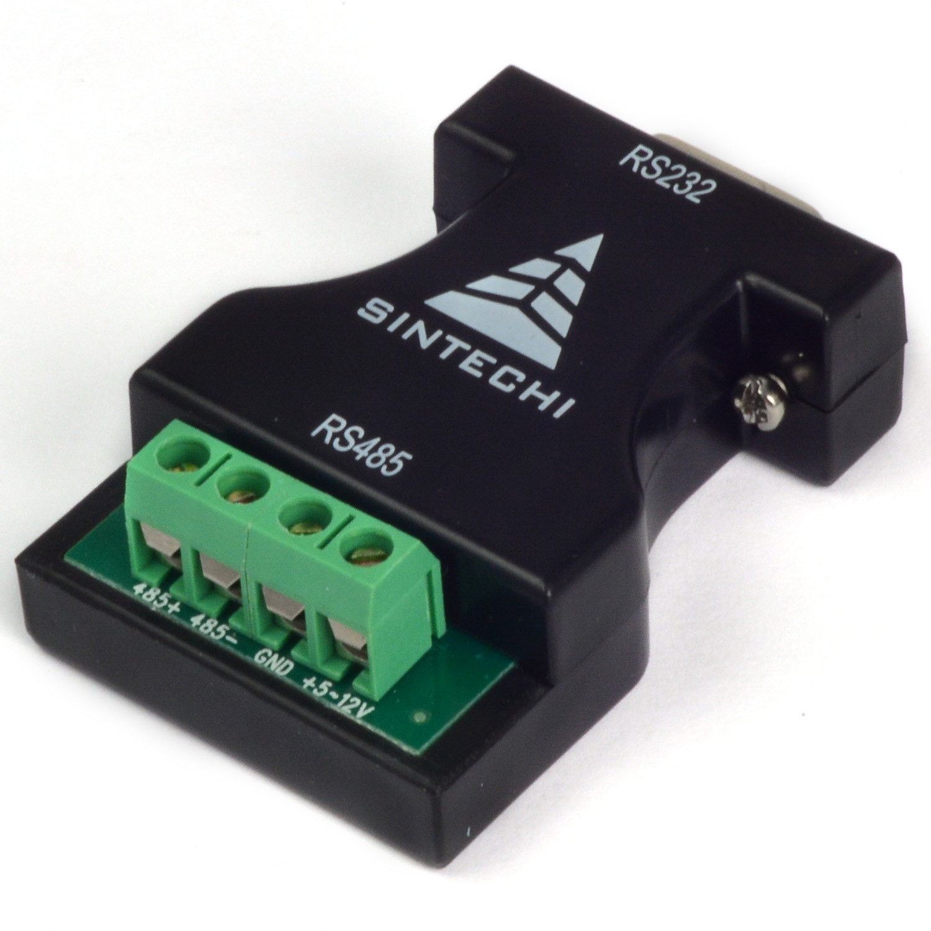
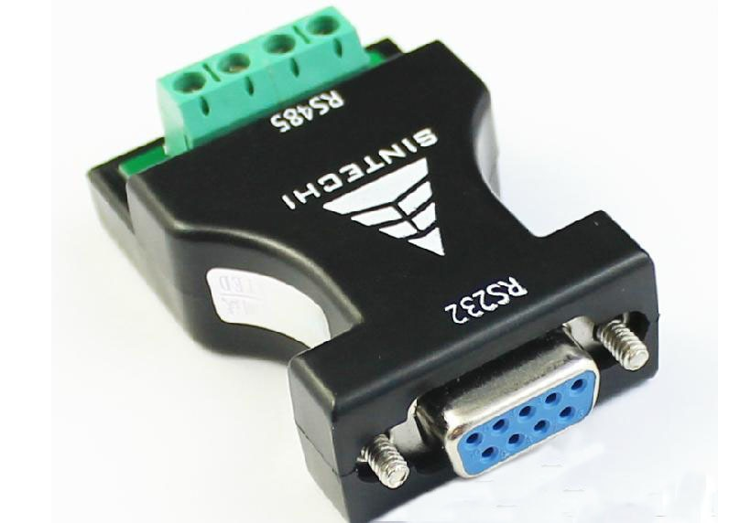
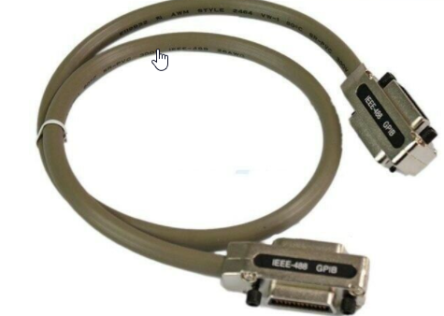
Hardware /Links with Computer
Ports for data acquisition
RS232
IEEE-488 (GPIB (General Purpose Interface Bus)
Printer port
Sound Card ports
Specially designed BUS Cards
DAQ cards
© 2015 ELSIVER, All rights reserved. compiled by Dr. Osama Hosameldeen

Slide 28
Software
Application software can be a full screen interactive panel,
A dedicated input/output control program,
A data logger,
A communications handler,
Or a combination of all of these.
© 2015 ELSIVER, All rights reserved. compiled by Dr. Osama Hosameldeen

Slide 29
Options for software
Program the registers of the data acquisition hardware directly
Utilize low-level driver software, usually provided with the hardware, to develop a software application for the specific tasks required
Utilize off-the-shelf application software
(third party packages such as LabVIEW and Labtech Notebook provide a graphical interface for programming)
© 2015 ELSIVER, All rights reserved. compiled by Dr. Osama Hosameldeen

Slide 30
PC
Depending on the
particular application,
the microprocessor speed,
hard disk access time,
disk capacity and
the types of data transfer available,
Can all have an impact on the speed at which the computer is able to continuously acquire data.
© 2015 ELSIVER, All rights reserved. compiled by Dr. Osama Hosameldeen

Slide 31
Summery
Sensors and transducers
Field wiring
Signal conditioning
Data acquisition hardware
PC (operating system)
Data acquisition software
© 2015 ELSIVER, All rights reserved. compiled by Dr. Osama Hosameldeen

